Slide 1
Cracking the system engineering nut
A tale of trade-offs and introspection.

Slide 2
System engineering - what it is and is not
Formal definitions of system engineering often define it in terms of a host of steps, processes and special software tools. e.g. https://en.wikipedia.org/wiki/Systems_engineering
In practice it is more simply a scaled-up version of most technical work, encompassing multiple technical fields and doing all cross-checking and documentation that you’ve been told you should be doing.
  A spreadsheet, relational database and/or your own custom software are often perfectly suitable and you don’t have to use very expensive formal requirements management software such as DOORS (https://www.ibm.com/products/requirements-management), QA process tracking and approval software.
  It is about having the discipline to be through, maximising information sharing and encouraging the discussion of concerns. The more eyes to spot problems made visible by clear documentation, the smoother a project goes.
  Expensive technical field specific software is often required, e.g. for thermal and physical load modelling.
What a system engineer isn’t is being all knowing and experienced in every technical field and aspect of a project; it is about asking the questions to tease out the details and points of concern of others:
  How can any team member find the details of this sub-system to understand how it works?
  How can any team member see the trade-offs, points you’ve considered and analysis performed?
  How can any team member see the interfaces and control/telemetry data that is required/produced for normal operation, unexpected conditions and what the significance is of it all?
  How can any team member tell how everyone have/will demonstrate that the equipment they are developing/providing works in isolation, in conjunction with the rest of the system, under every imaginable fault condition and also exactly what scenarios may not be survivable?
A system engineer pushes the team members towards technical excellence rather than providing it.

Slide 3
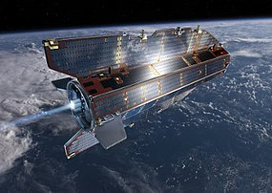
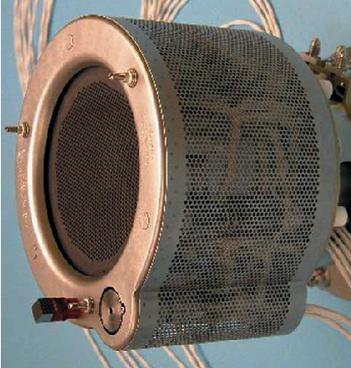
GOCE anomalous plasma potential
Thruster assembly
Thruster
Xenon gas flow control unit
Ion Propulsion Control Unit (IPCU)
Satellite main computer
Science computer generating drag nulling data
Thruster power supplies
Satellite power systems
Neutraliser
The ESA Gravity and Oceanic Circulation Explorer (GOCE) satellite was launched in 2009 to primarily study the Earth’s gravitational field and ocean currents.
To achieve the science goals the satellite had a very low orbit with a short lifespan due to the drag of the thermosphere.
A QinetiQ 20mN ion thruster IPCU compensated for the drag by nulling out the average longitudinal gravity gradiometer signal with a charge neutralising electron beam to prevent satellite charge up.
Unexpectedly, the ion thruster left the satellite chassis with a voltage differential with respect to the thermosphere leading to an erroneous signal contribution in some of the science instruments.
This contradicted the ground based test results and the behaviour put into question the health, longevity and development process of the propulsion system.
The GOCE satellite had an orbital lifespan of a couple months after launch before drag would increase to the point that the satellite could not be recovered and so an urgent anomaly investigation and corrective action process was started.

Slide 4
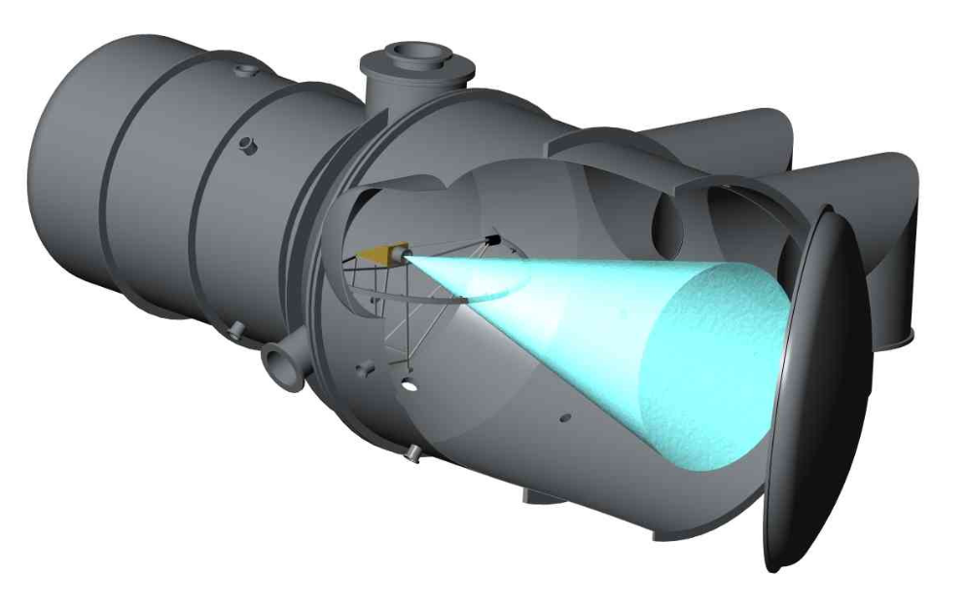
GOCE Ion Thruster test chamber adaptation
GOCE IPCU Unit Tester Rack
Xenon supply
Ground, signal and voltage reference control.
Floating relay drive, sense, PPS and data I/O
Control computer.
GUI for state and scripted test control.
Satellite and drag data simulation.
Vacuum control and monitoring infrastructure
Floating output satellite power bus emulation.
A physical simulation of the on-orbit situation and the test vacuum chamber set-up concluded that the grounding of the vacuum chamber wall modified the electric potentials which could be corrected by driving the thruster assembly chassis to an appropriate voltage with respect to the vacuum chamber.
Fortuitously, the IPCU Unit Tester (designed to allow engineering and flight thruster assembly testing) could drive voltage reference potentials of all electrical connections including chassis potentials.
  The floating digital I/O and control signals were managed by an microcontroller on a floating PCB.
  Communication with the test rack control computer is via an optical link.
  Galvanically isolating DC-DC convertors supply the power and voltage reference control or isolation via relays.
Installation of some electrically isolating mounts and a small section of electrically isolating pipe allowed the required conditions to be created with the test behaviour agreeing with the simulation predictions.
Modifications to the IPCU closed control loops were then tested and a limited re-qualification campaign performed for ESA to accept the modifications.
With the anomalous on-orbit plasma potential explained by simulations with corroborating test data, the IPCU control software update was sent to the in orbit GOCE satellite successfully.

Slide 5
System optimisation example
Optimising the design of a solar powered high altitude UAV requires considering many factors including:
  Aircraft planform type (general top view layout).
  Wing span, chord and total area.
  Number of fuselages.
  Control surface types and sizes.
  Static and dynamic stability.
  Susceptibility to turbulence and gust fronts.
  Fuselage to wing connection arrangement.
  Solar illumination angles and flight attitudes.
  Solar heating including cloud reflections.
  Solar cell sizes, positioning and total area.
  Internal volumes for electronics and batteries.
  Payload mounting locations.
  Insulation and thermal control.
The optimisation is to maximise the operation of all proposed payload types with a scoring method.
  This must be developed by working with customer or end data user representatives to ensure you are optimising for the correct thing.
Impractical to include everything in an aircraft system model and then search for global optimums.
Instead use a combination of high fidelity modelling and direct experimental testing to predict the optimum way of trading off particular combinations of considerations.
  E.g. for a given structure target strength and stiffness, what is the optimum design type and how large / heavy would it ideally be.
  Amount of batteries and their distribution.
  Wiring loom lengths, cross-talk, resistances and mass.
  Night altitude management and wind drift.
  General structural element design.
  Structural, fairing and envelope mass.
  Wing surface roughness and shape control.
  Aerodynamic drag and lift.
  Aerodynamic interactions between surface structures.
  Number and location of propellers.
  Location of propellers and their aerodynamic effect on the lifting and control surfaces.
  Performance at different latitudes, climates and times of year.
  Type of payload operation desired.

Slide 6
System optimisation process
Collect the derived trade-off relationships together and use them to perform system optimisation.
Typical computational physics techniques can be used to perform the optimisation.
  Iterative simplex.
  Simulated annealing.
  Manual selection and adjustment.
Must be careful about the range of applicability for each derived relationship and hidden assumptions/limitations.
  Safety margins and manufacturability constraints.
  E.g. suitable battery packs can only be made in certain sizes.
Re-run the models for your identified optimum design and ensure the sub-system experts .
  Expect to repeat the optimisation process several times as it is human nature to only think of or notice problems when given a system design into which they need to deliver parts and begin detailed work.
Perform appropriate concept testing to validate the system design as early as possible.
Multitude of design considerations
Multiple sets of trade-offs modelled or experimentally measured in detail.
Each trade-off evaluated into a best case relationship between design choice factors.
Prospective optimised system design identified for payload operation with performance predictions.
Design review and sub-system detailed design find new constraints, limitations and considerations.
Concept testing.
(Often extends into design phase).

Slide 7
Example system considerations for a small satellite
Regulatory approval for the operation and design of the ground – satellite link.
Launch provider approval of the satellite structure, any deployable elements and power up.
Battery charge retention while the satellite is held inert for a long time in the lead up to a launch.
Power generation and usage prior to satellite stabilisation and deployment of any solar panels.
Reliable deployment of solar arrays and sun facing control.
Battery charging system automation and management of differentially degrading batteries.
Communication with a potentially tumbling satellite.
Automatic survival safe mode and what is automated rather than explicitly commanded.
Instrument survival and operation after being subject to launch loads and solar thermal flux.
Satellite precision orientation determination and control for earth observation pointing.
Orbital parameter determination and appropriate satellite tasking.
Immunity from malicious attackers on to the communication link and confidentiality of data.
Satellite sub-system lifespan and susceptibility to magnetic field flux and radiation latch-up.
Satellite state of health determination, ability to investigate anomalies and software updates.
Mitigating inadvertently dangerous operation through human error, malfunction or failures.

Slide 8
R&D one-off build project steps
These are generalisations; long lead time custom structure will have a longer build phase while software might undesirably be under development right up to half way through system testing.
Requirements (~2%) | What are you trying to achieve? What restrictions do you have to abide by? What counts as success? Consult with the customer, regulatory authorities and key suppliers.
Experimental prototypes and trade-offs (~30%) | What are the things you need to consider? What does or doesn’t behave as you assume? How do available equipment and components behave? Which potential failure modes exist? How will it be operated?
Design (~20%) | What exactly are you going to make? What is it’s predicted performance and variation? What monitoring/testing do you need to do during the build to ensure success? How will testing be performed and what are the pass criteria? Obtain customer and regulatory approval.
Build and unit test (~30%) | Make the various sub-systems fully finished and ready for integration. Unit test the sub-systems and commit to them being acceptable or perform remedial work and repeat the testing.
Integrate and system test (~13%) | Integrate the sub-systems into the final product. Perform full system end-to-end tests. Obtain customer and regulatory approval.
Training and procedures (~5%) | Write the user manual! How should it be operated? What regular housekeeping needs to be done? What does the operator need to monitor and how should they react to what they find? What can be diagnosed by the operator and how would it be done? Practice your procedures. Train the customer.

Slide 9
Simple cautionary tales of system engineering failure
A 2002 investigation of why an instrument failed (no telemetry or response to commands) shortly after being activated on orbit started with creating a list of all critical components and imagined failure modes. The investigation found the likely failure after someone said “Wait, what is a pulsed relay?”
  The significance of the difference between a normally open power relay that is activated when driven continuously versus a latching relay driven by a ~100ms forward current pulse to latch close and a ~100ms reverse current pulse to latch open was not clearly communicated between engineers.
  The engineers concerned, reviewers and system engineers did not notice the disconnect between the two sub-systems because the interface and operation documentation did not make the functioning and required control process clear.
  When tested in open air, the relay did not overheat despite extended usage, falsely giving a sense of reliability.
  When tested in a thermal vacuum chamber, either the conditions (vacuum quality / worst case solar heating) were not suitably reproduced or the test did not run long enough to fail.
  It was concluded that the relay could not survive being continuously driven under on-orbit conditions; heat build-up caused the control solenoid windings to perish.
Physical testing of flight equipment at both sub-system and instrument will not detect all mistakes.
Clear and detailed documentation created early in the project would have maximised the chance of this mistake being avoided during the design stages or caught during document review and cross-referencing or caught by the system engineers.
  In reality, you can never think of everything, test for everything or avoid all risk; quality assurance involves trading-off cost and schedule with a diminishing return on the reduction of risk with further effort.
  You can minimise the opportunity for a catastrophic mistake by documenting your design as you design it and benefiting from the value this provides rather than treating documentation as an unwelcome activity.

Slide 10
Simple cautionary tales of system engineering failure
A 2004 initial proof of concept test flight of a high altitude unmanned drone aircraft prototype failed as the aircraft became uncontrollable at low angles of attack as the aerodynamic wing twisting loads induced by the roll control aerodynamic surfaces cancelled out the control surface effect.
  The aircraft stability and control analysis was performed in isolation to the structural analysis.
  The aerodynamic roll control surfaces induced significant wing torsion loads that deformed the wing.
  The wing deformation acted opposite to the roll control surfaces, reducing their effectiveness.
  At low angles of attack (higher speeds) this effect became more pronounced with the wing twist effect growing stronger than the roll control surface effectiveness.
  The aircraft behaviour became counter-intuitive and the remote pilot had very little time to try to understand what was happening and how to regain control of the aircraft.
The dynamic feedback conditions were not considered and no loss of roll control recovery procedure identified or practised; not from an intentional disregard of the possibility, but just due to the belief that the design was workable and a lack of experience within the team.
  It is absolutely essential to have a working culture where there is the freedom for anyone to critique the design and consider failure possibilities; you can’t prevent or mitigate a potential problem if you didn’t think of it.
  Separating the responsibility for justifying the prediction of success from looking for potential causes of concerns avoids what could be a significant unconscious conflict of interest that can be hard to recognise.
This is a related design failure to the 2003 loss of the Helios high altitude unmanned aircraft from which lessons could have been learned to consider the dynamic behaviour of such aircraft under adverse conditions (https://en.wikipedia.org/wiki/AeroVironment_Helios_Prototype).
  Learning from other people’s expensive failures is a very cheap way to potentially avoid a catastrophic problem.

